Slide 1
Mithril:
Missile and Ballistics
Detection System
Ajay Thakkar
Juan Jimenez
Tomas Esson
Notes:
Juan

Slide 2
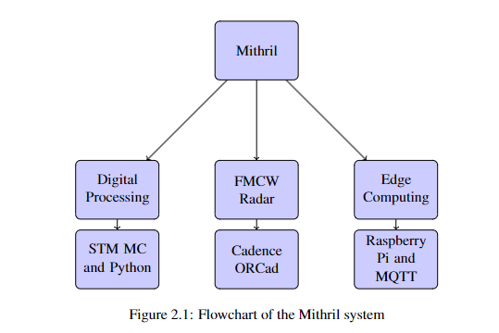
What is Mithril?
Nodal FMCW Phased Array Radar System
Small radar nodes that can beamsteer electronically
Nodes communicate with each other to actively track projectiles
Network is dynamic, number of nodes do not matter
All processing and networking done on edge
Notes:
Juan

Slide 3
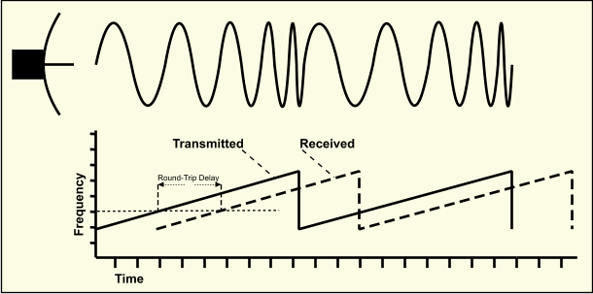
FMCW and Phased Array Theory
Frequency Modulated Continuous Wave (FMCW)
Transmitted wave changes in frequency linearly over time (chirp).
Received wave takes time to come back, making its signal delayed.
Difference in frequency between Rx and Tx corresponds to distance and velocity.
Phased Array
Having two antennas with different phase (time delay) causes construction and destruction, enabling the resulting wave to be steered.
Notes:
Juan

Slide 4


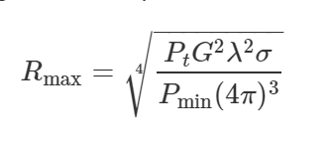
Theoretical Radar Capability
Noise Figure (Friis Equation): 1.526758125
Noise Floor (Minimum Detectable Power): -103.35 dB
Maximum Range of Radar: ~89 m
Notes:
Ajay

Slide 5
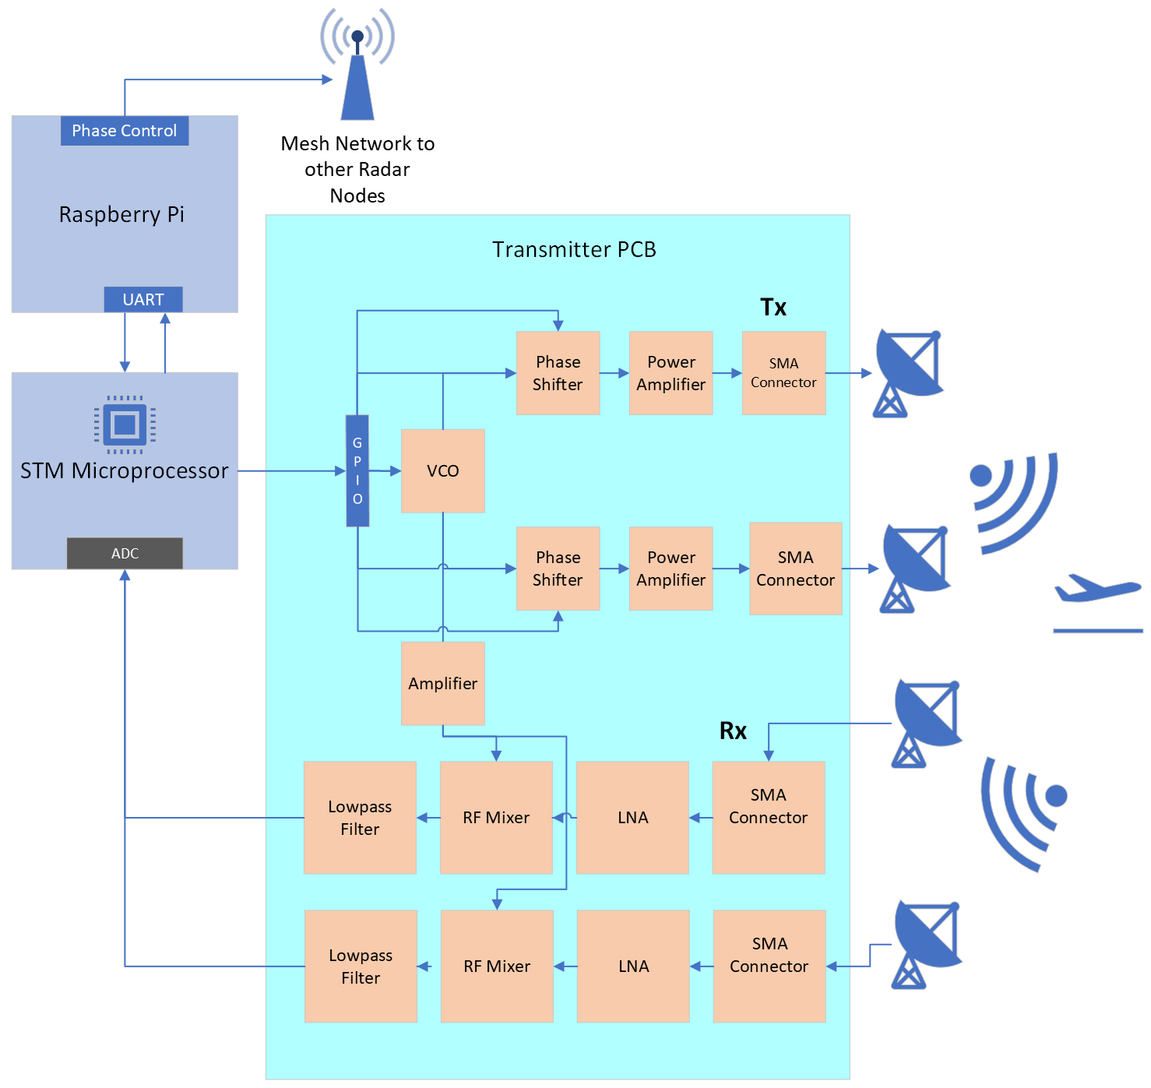
Overview
Notes:
Ajay

Slide 6
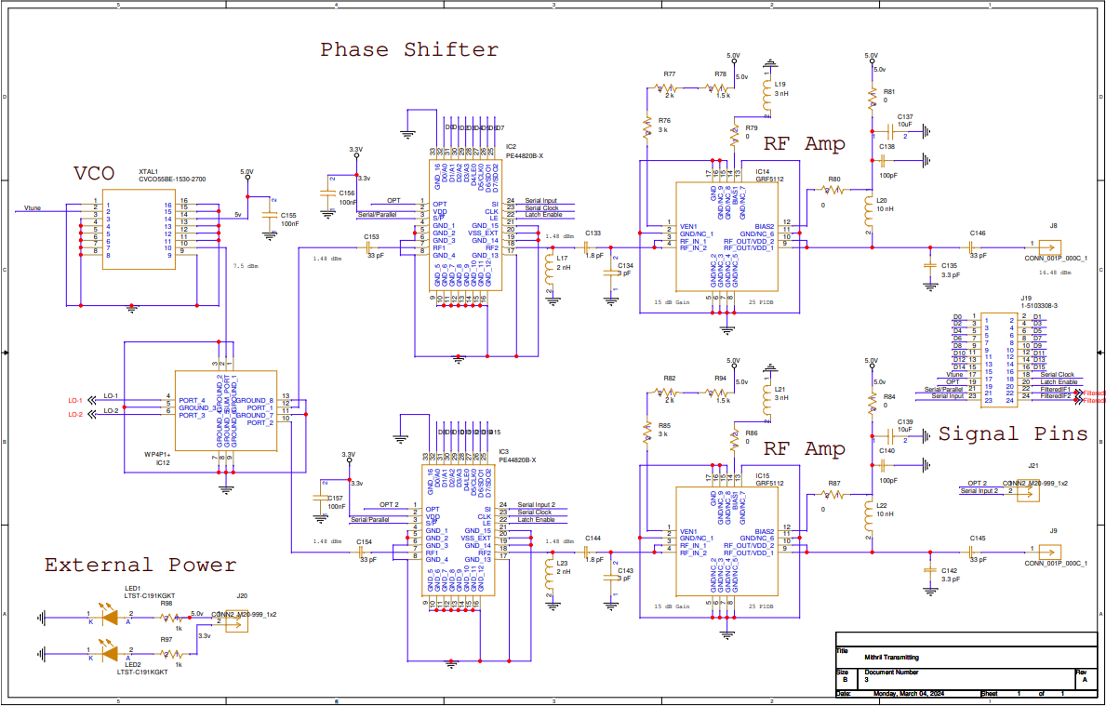
Electronic Schematic
Transmitting
Notes:
Ajay

Slide 7
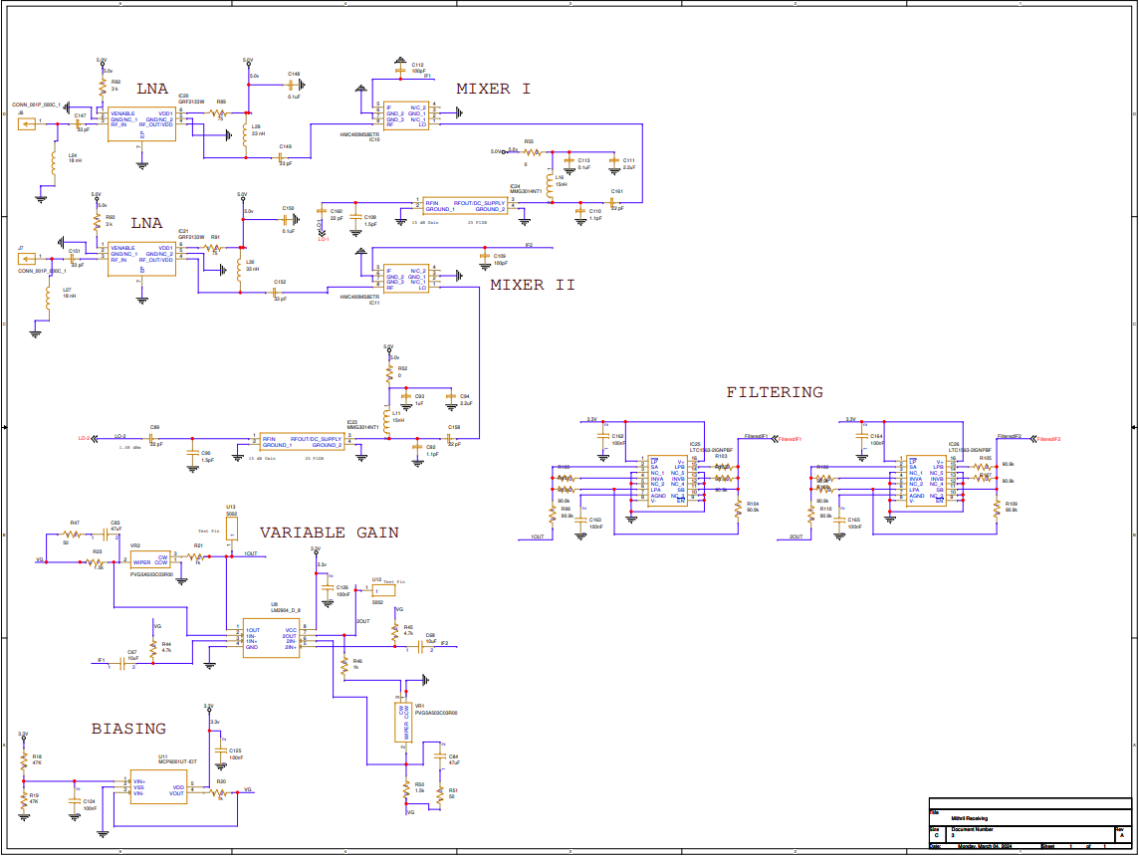
Receiving
Notes:
Ajay

Slide 8
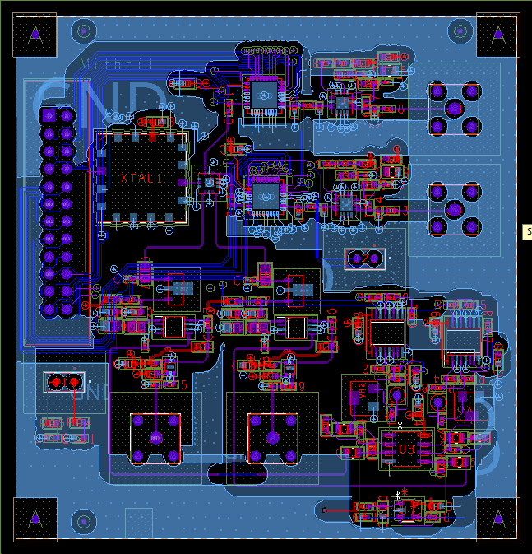
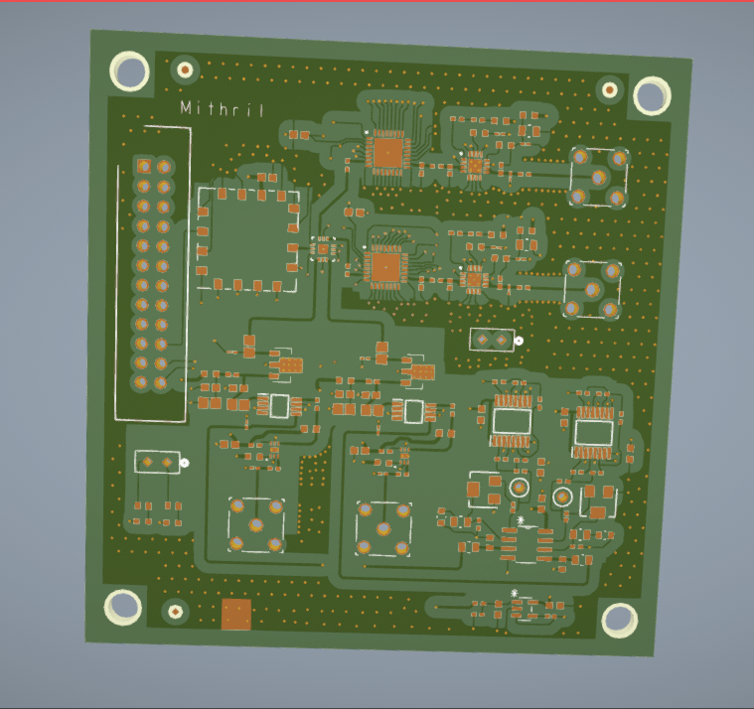
PCB Design
Notes:
Juan

Slide 9
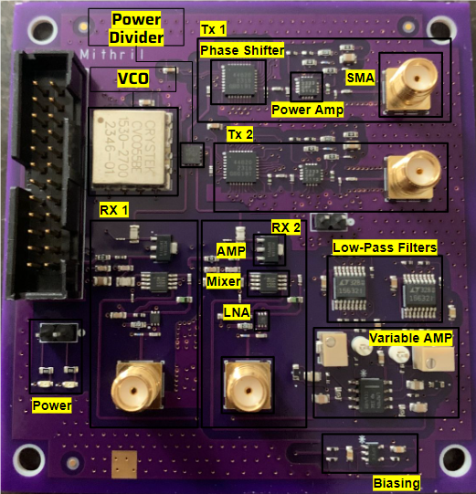
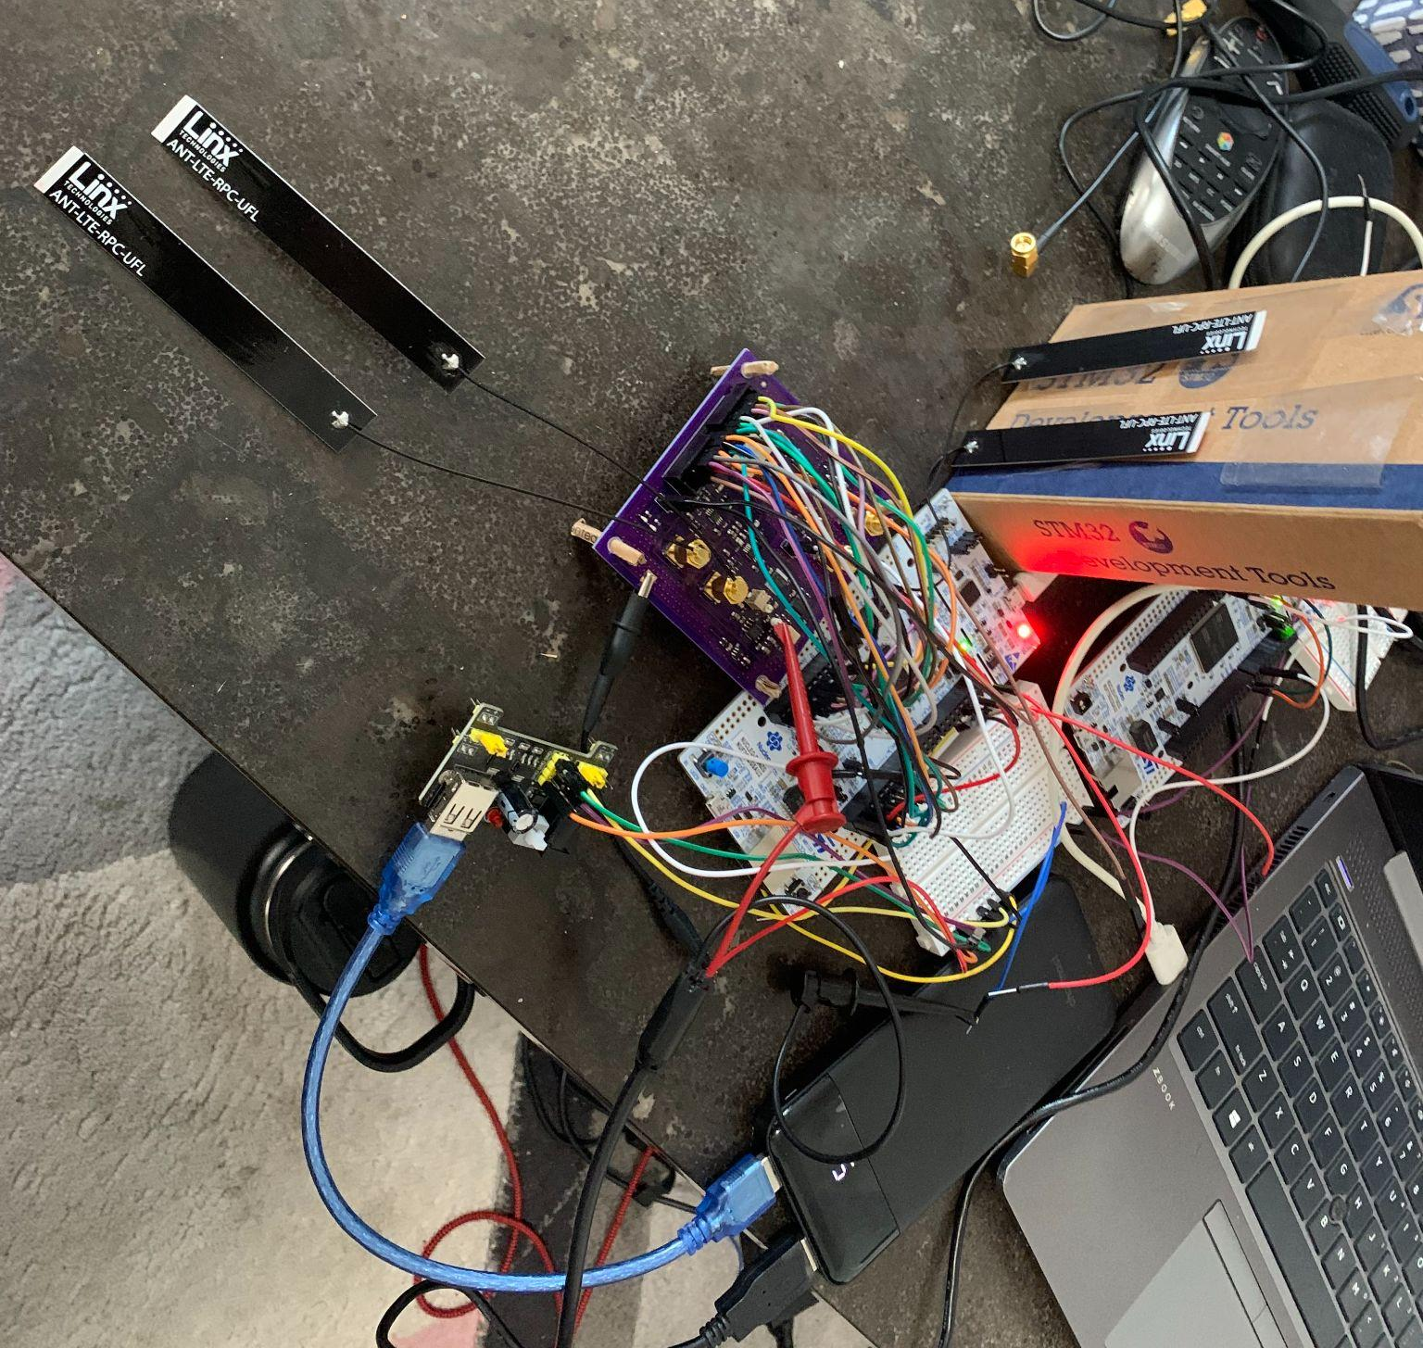
Finished Product
Notes:
Juan

Slide 10
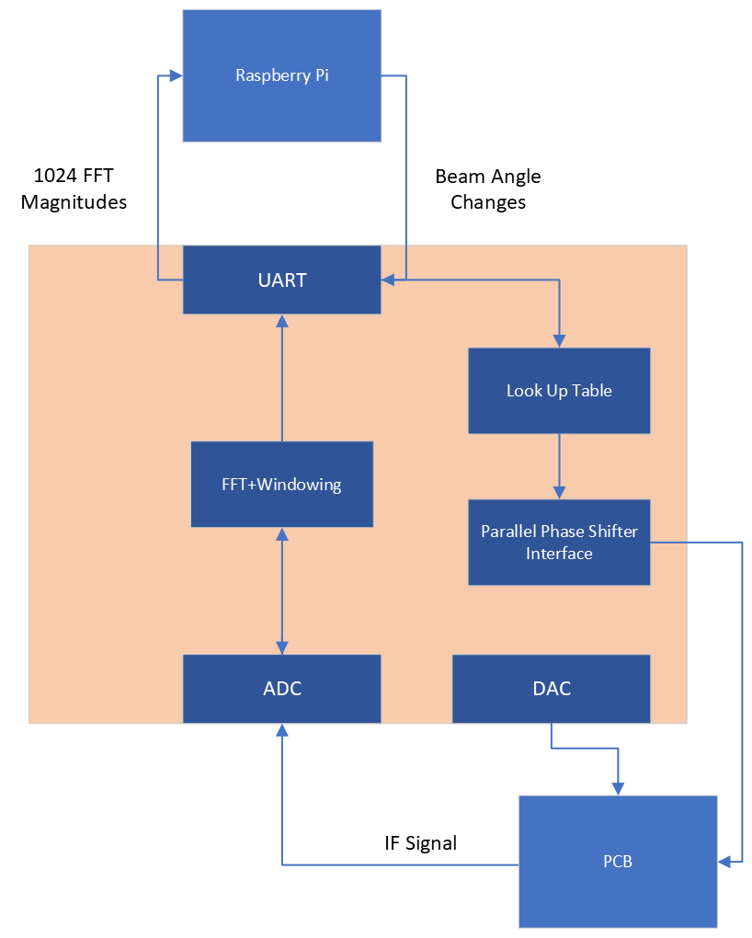
Digital Processing: Microprocessor
Handles sampling of signal, ramp voltage, processing, phase control, and communication
Uses DMA for UART, ADC, and DAC peripherals to allow for parallel processing
Allows for easy changes to sampling rate, chirp time, and chirp frequency
Notes:
Ajay

Slide 11
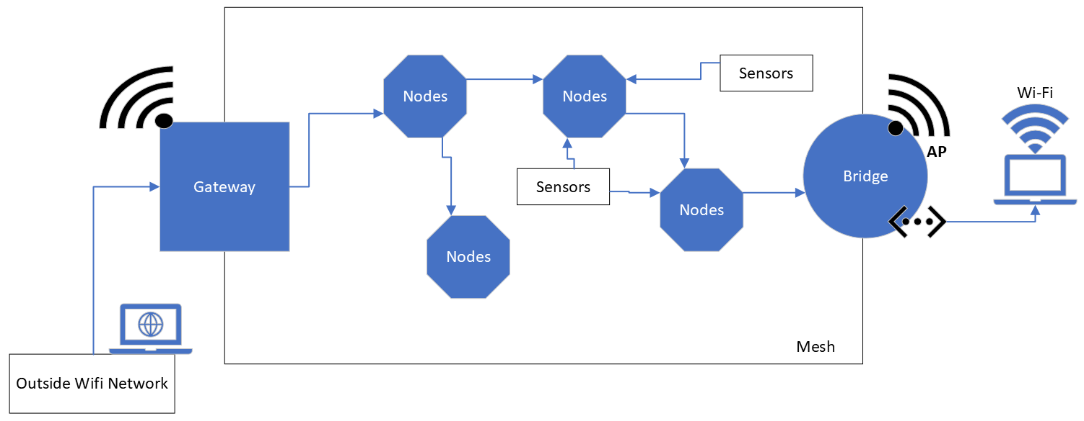
Mesh Network
Mesh Video
Notes:
Juan

Slide 12
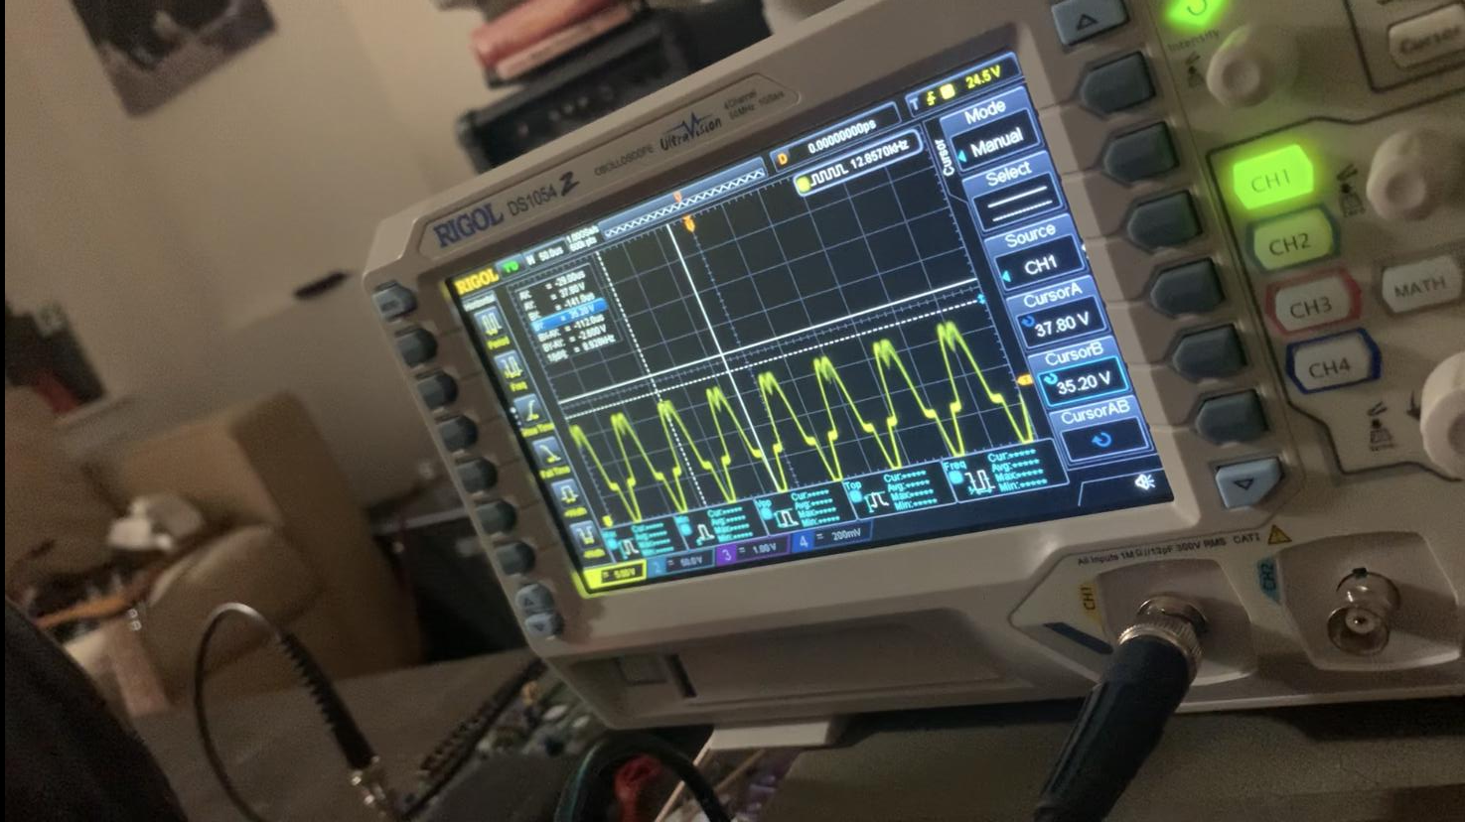
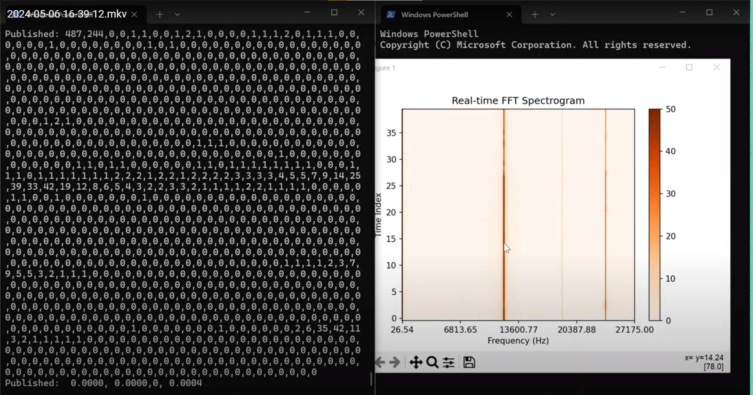
Results
Video
Video
Notes:
Ajay

Slide 13
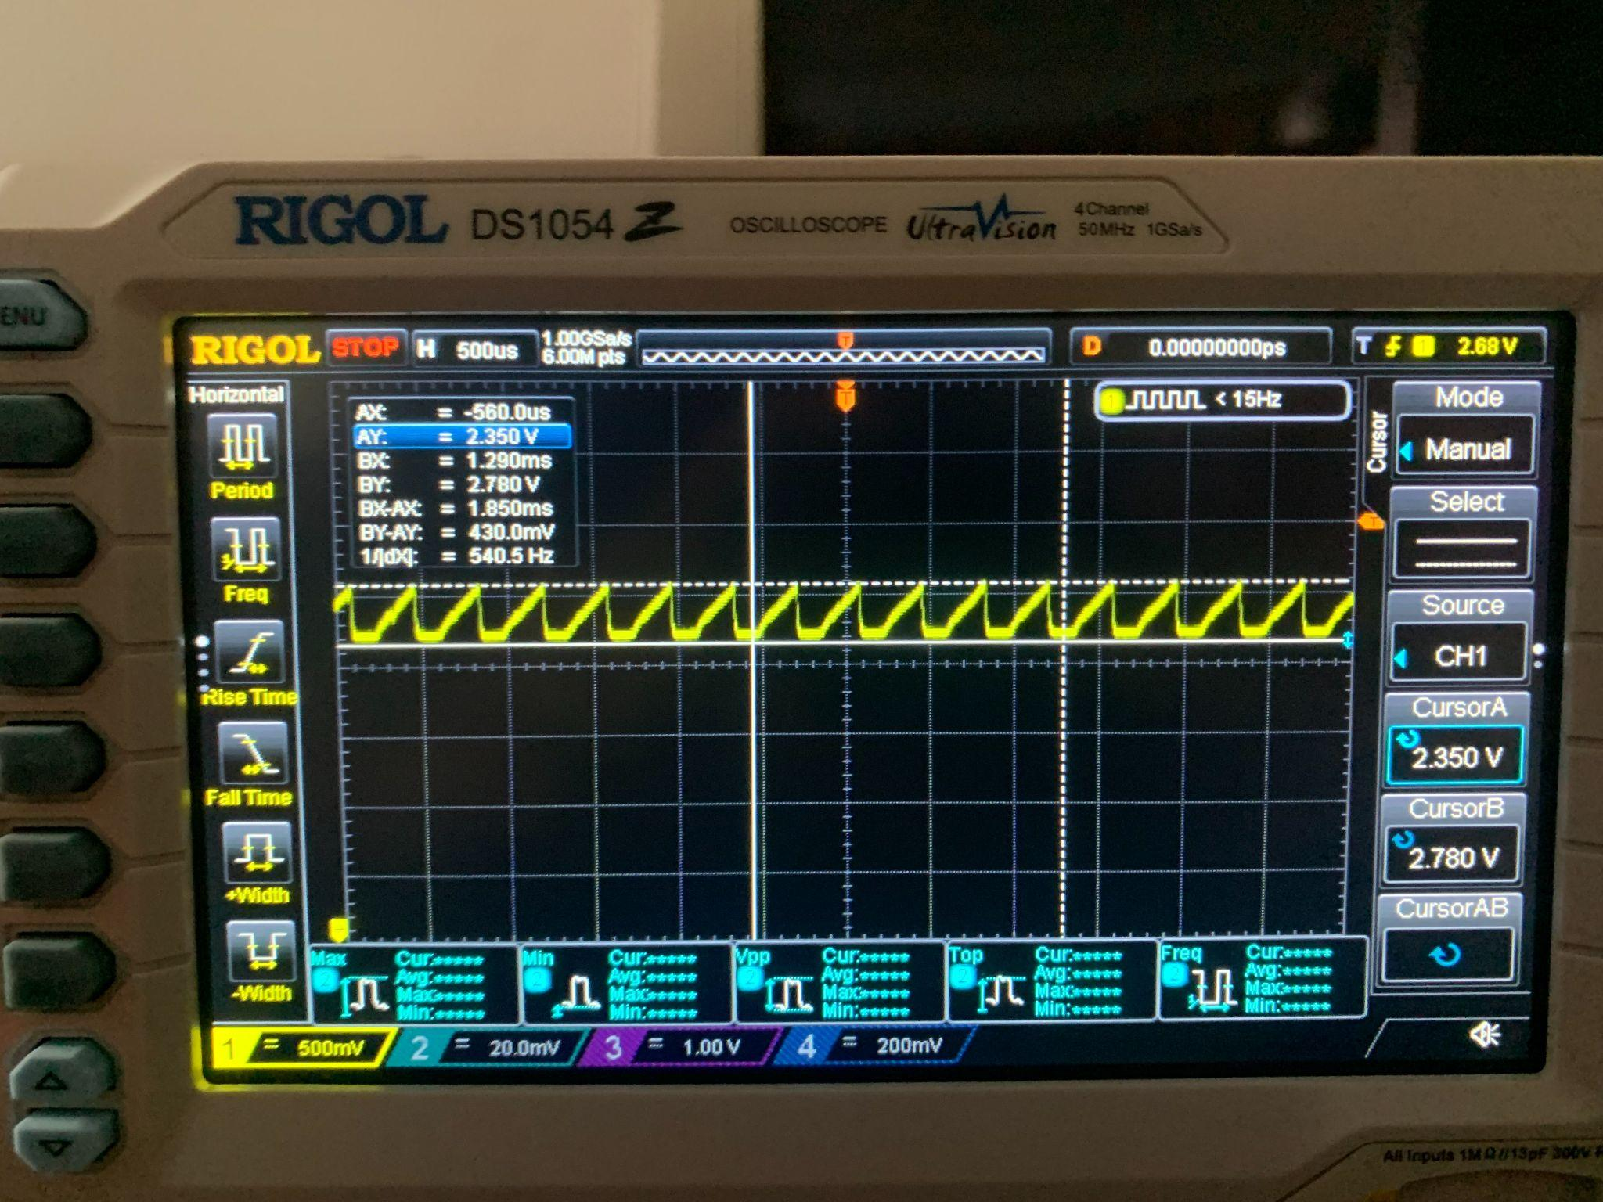
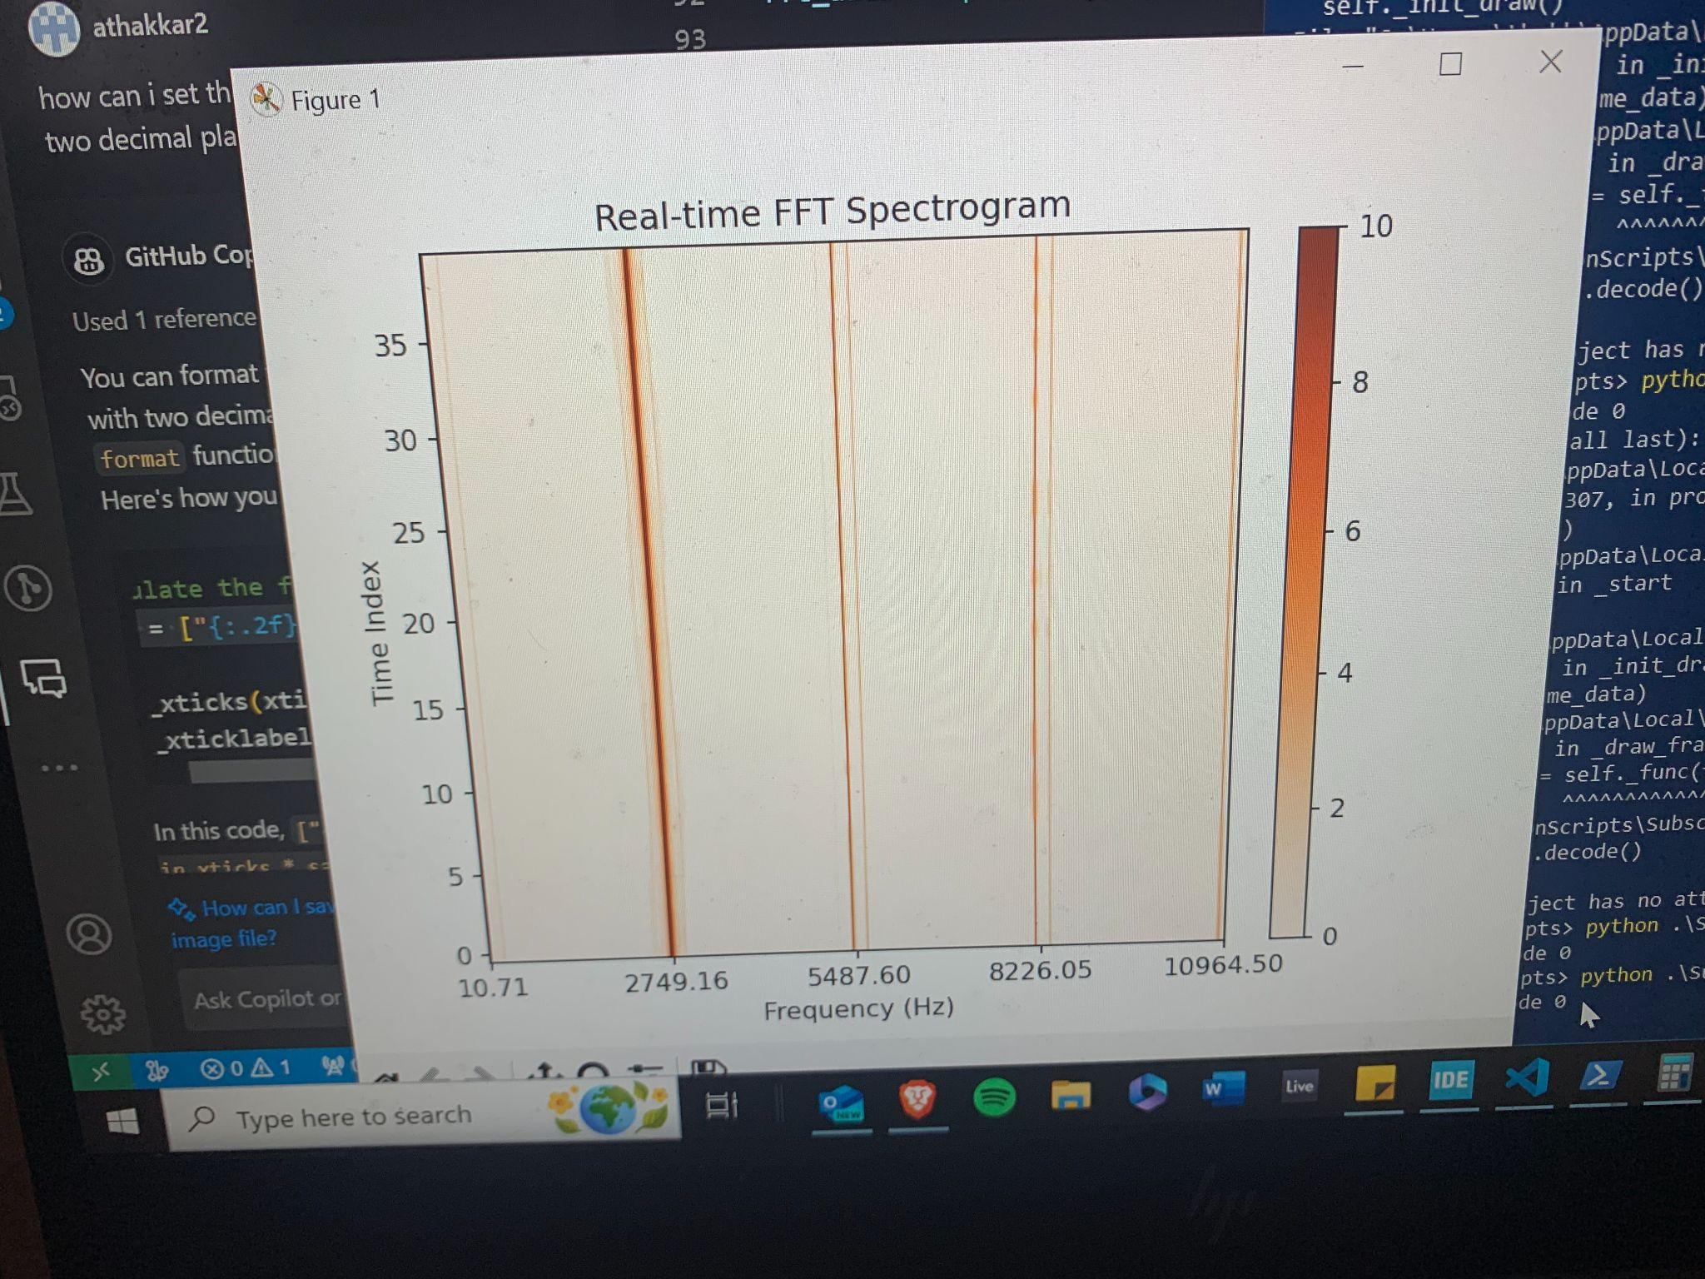
Issues
With no antennas plugged in, signal is still output
Leakage signal from VCO which saturates mixer, and dilutes return signal
Filtering stage has cutoff frequency of 28 KHz, but is located after amplifying stage making it difficult to isolate leak
Notes:
Juan

